Slide 1

Data Management Using Microsoft SQL Server
SQL
Server
2012
Session: 1
Introduction to the Web
Session: 9
Advanced Queries and Joins

Slide 2

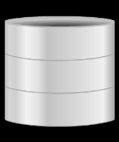

SQL
Server
2012
SQL
Server
2012
Explain grouping and aggregating data
Describe subqueries
Describe table expressions
Explain joins
Describe various types of joins
Explain the use of various set operators to combine data
Describe pivoting and grouping set operations
2

Slide 3

SQL
Server
2012
SQL Server 2012 includes several powerful query features that help you to retrieve data efficiently and quickly.
Data can be grouped and/or aggregated together in order to present summarized information.
Using the concept of subqueries, a resultset of a SELECT can be used as criteria for another SELECT statement or query.
Joins help you to combine column data from two or more tables based on a logical relationship between the tables.
Set operators such as UNION and INTERSECT help you to combine row data from two or more tables.
The PIVOT and UNPIVOT operators are used to transform the orientation of data from column-oriented to row-oriented and vice versa.
The GROUPING SET subclause of the GROUP BY clause helps to specify multiple groupings in a single query.
SQL
Server
2012
3

Slide 4
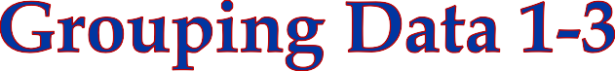



SQL
Server
2012
SQL
Server
2012
The GROUP BY clause partitions the resultset into one or more subsets. Each subset has values and expressions in common.
For every grouped column, there is only one row. The GROUP BY clause can have
more than one grouped column.
The syntax for GROUP BY clause is as follows:
Syntax:
CREATE TYPE [ schema_name. ] type_name { FROM base_type [ ( precision [ , scale ] ) ] [ NULL | NOT NULL ] } [ ; ]
where,
column_name: is the name of the column according to which the resultset should
be grouped.
4

Slide 5

SQL
Server
2012
SQL
Server
2012
Consider the WorkOrderRouting table in the AdventureWorks2012
database.
The total resource hours per work order needs to be calculated.
To achieve this, the records need to be grouped by work order number, that is,
WorkOrderID.
Following code snippet retrieves and displays the total resource hours per work order along with the work order number:
SELECT WorkOrderID, SUM(ActualResourceHrs) AS TotalHoursPerWorkOrder FROM Production.WorkOrderRouting GROUP BY WorkOrderID
In this query, a built-in function named SUM() is used to calculate the total.
SUM() is an aggregate function.
Aggregate functions will be covered in detail in a later section.
5

Slide 6

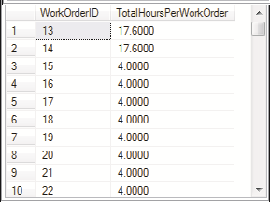
SQL
Server
2012
SQL
Server
2012
Executing this query will return all the work order numbers along with the total number of resource hours per work order.
A part of the output is shown in the following figure:
6

Slide 7
SQL
Server
2012
SQL
Server
2012
The WHERE clause can also be used with GROUP BY clause to restrict the rows for grouping.
The rows that do not meet the conditions in the WHERE clause are eliminated before any grouping is done.
Following code snippet shows a query that limits the rows displayed, by considering only those records with WorkOrderID less than 50:
SELECT WorkOrderID, SUM(ActualResourceHrs) AS TotalHoursPerWorkOrder FROM Production.WorkOrderRouting WHERE WorkOrderID <50 GROUP BY WorkOrderID
7

Slide 8
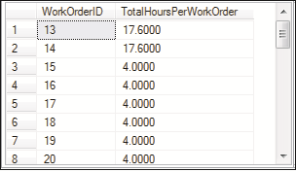
SQL
Server
2012
SQL
Server
2012
As the number of records returned is more than 25, a part of the output is shown in the following figure:
8

Slide 9
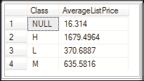
SQL
Server
2012
SQL
Server
2012
If the grouping column contains a NULL value, that row becomes a separate group in the resultset.
Consider the Production.Product table. There are some rows in it that have
NULL values in the Class column.
Following code snippet retrieves and displays the average of the list price for each class:
SELECT Class, AVG (ListPrice) AS 'AverageListPrice' FROM
Production.Product GROUP BY Class
As shown in the following figure, the NULL values are grouped into a single row in
the output:
9

Slide 10
SQL
Server
2012
SQL
Server
2012
The ALL keyword can also be used with the GROUP BY clause. It is significant only when the SELECT has a WHERE clause.
It even includes those groups which do not meet the search conditions.
The syntax of using GROUP BY with ALL is as follows:
Syntax:
SELECT <column_name> FROM <table_name> WHERE <condition> GROUP BY ALL
<column _name>

Slide 11
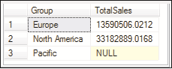
SQL
Server
2012
SQL
Server
2012
Consider the Sales.SalesTerritory table.
This table has a column named Group indicating the geographic area to which the
sales territory belongs to.
Following code snippet calculates and displays the total sales for each group:
SELECT [Group],SUM(SalesYTD) AS 'TotalSales' FROM Sales.SalesTerritory WHERE [Group] LIKE 'N%' OR [Group] LIKE 'E%' GROUP BY ALL [Group]
The output needs to display all the groups regardless of whether they had any sales or not.
To achieve this, the code makes use of GROUP BY with ALL.
Apart from the rows that are displayed, it will also display the group 'Pacific' with
null values as shown in the following figure:
This is because the Pacific region did not have any sales.

Slide 12
SQL
Server
2012
SQL
Server
2012
HAVING clause is used only with SELECT statement to specify a search condition
for a group.
Once you have created groups with a GROUP BY clause, you may wish to filter the results further.

Slide 13
SQL
Server
2012
The syntax of GROUP BY with HAVING is as follows:
Syntax:
SQL
Server
2012
SELECT <column_name> FROM <table_name> GROUP BY <column_name> HAVING
<search_condition>
Following code snippet displays the row with the group 'Pacific' as it has total sales less than 6000000:
SELECT [Group],SUM(SalesYTD) AS 'TotalSales' FROM Sales.SalesTerritory
WHERE [Group] LIKE 'N%' OR [Group] LIKE 'E%' GROUP BY ALL [Group]
The output of this is only row, with Group name Pacific and total sales, 5977814.9154.

Slide 14

SQL
Server
2012
SQL
Server
2012
CUBE is an aggregate operator that produces a super-aggregate row.
The summary row is displayed for every possible combination of groups in the resultset.
The syntax for CUBE is as follows:
Syntax:
SELECT <column_name> FROM <table_name> GROUP BY <column_name> WITH CUBE

Slide 15

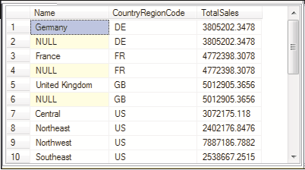
SQL
Server
2012
Following code snippet demonstrates the use of CUBE:
SQL
Server
2012
SELECT Name,CountryRegionCode,SUM(SalesYTD) AS TotalSales FROM
Sales.SalesTerritory WHERE Name <> 'Australia' AND Name<> 'Canada‘
GROUP BY Name,CountryRegionCode WITH CUBE
The query retrieves and displays the total sales of each country and also, the total of the sales of all the countries' regions.
The output is shown in the following figure:

Slide 16

SQL
Server
2012
SQL
Server
2012
In addition to the usual rows that are generated by the GROUP BY clause, it also introduces summary rows into the resultset.
It arranges the groups from the lowest to the highest.
The syntax of ROLLUP is as follows:
Syntax:
SELECT <column_name> FROM <table_name> GROUP BY <column_name> WITH ROLLUP

Slide 17

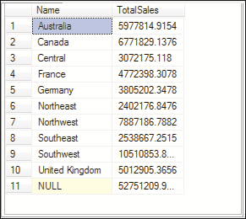
SQL
Server
2012
Following code snippet demonstrates the use of ROLLUP:
SQL
Server
2012
SELECT Name, CountryRegionCode,SUM(SalesYTD) AS TotalSales
FROM Sales.SalesTerritory
WHERE Name <> 'Australia' AND Name<> 'Canada' GROUP BY Name,CountryRegionCode
WITH ROLLUP
It retrieves and displays the total sales of each country, the total of the sales of all
the countries' regions and arranges them in order.
The output is shown in the following figure:

Slide 18
SQL
Server
2012
SQL
Server
2012
Aggregate functions help to perform analysis across rows, such as counting rows
meeting specific criteria or summarizing total sales for all orders.
Aggregate functions ignore NULLs, except when using COUNT(*).
Aggregate functions in a SELECT clause operate on all rows passed to the SELECT
phase. If there is no GROUP BY clause, all rows will be summarized.

Slide 19
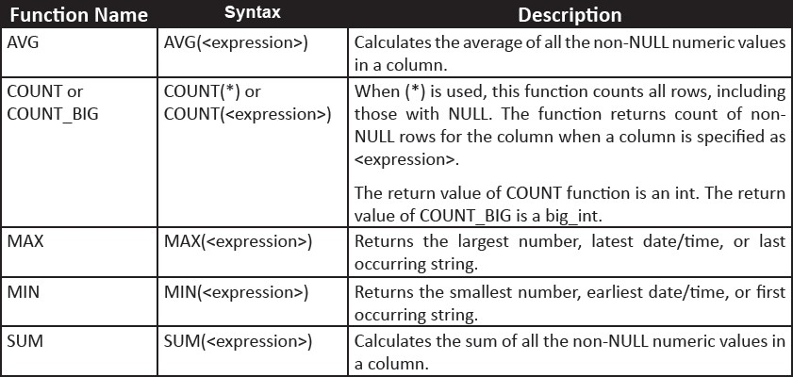
SQL
Server
2012
SQL
Server
2012
SQL Server provides many built-in aggregate functions.
The following table lists the commonly used functions:

Slide 20
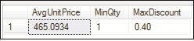
SQL
Server
2012
SQL
Server
2012
The following code snippet demonstrates the use of built-in aggregate in a SELECT
clause:
SELECT AVG([UnitPrice]) AS AvgUnitPrice,
MIN([OrderQty])AS MinQty, MAX([UnitPriceDiscount]) AS MaxDiscount
FROM Sales.SalesOrderDetail;
Since the query does not use a GROUP BY clause, all rows in the table will be summarized by the aggregate formulas in the SELECT clause.
The output is shown in the following figure:
When using aggregates in a SELECT clause, all columns referenced in the SELECT list must be used as inputs for an aggregate function or must be referenced in a GROUP BY clause.
Failing this, there will be an error.

Slide 21
SQL
Server
2012
The following code snippet will return an error:
SQL
Server
2012
SELECT SalesOrderID, AVG(UnitPrice) AS AvgPrice
FROM Sales.SalesOrderDetail;
This returns an error stating that the column Sales.SalesOrderDetail.SalesOrderID is invalid in the SELECT list because it is not contained in either an aggregate function or the GROUP BY clause.

Slide 22
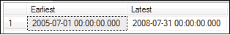
SQL
Server
2012
SQL
Server
2012
To correct or prevent the error, one needs to remove SalesOrderID from the query.
Besides using numeric data, aggregate expressions can also include date, time, and character data for summarizing.
Following code snippet returns the earliest and latest order date, using MIN and
MAX function:
SELECT MIN(OrderDate)AS Earliest,
MAX(OrderDate) AS Latest FROM Sales.SalesOrderHeader;
Following figure shows the output:

Slide 23
SQL
Server
2012
SQL
Server
2012
SQL Server provides several methods that help to aggregate two individual items of geometry or geography data.
The following table lists the methods:
Method | Description
STUnion | Returns an object that represents the union of a geometry/geography instance with another geometry/geography instance.
STIntersection | Returns an object that represents the points where a geometry/geography instance intersects another geometry/geography instance.
STConvexHull | Returns an object representing the convex hull of a geometry/geography instance.
A set of points is called convex if for any two points, the entire segment is contained
in the set.
The convex hull of a set of points is the smallest convex set containing the set.
For any given set of points, there is only one convex hull.

Slide 24
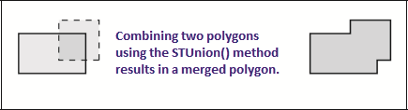
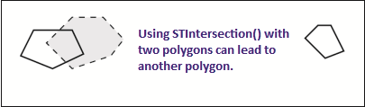
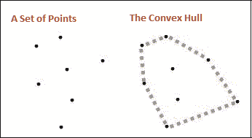
SQL
Server
2012
SQL
Server
2012
Following figure depicts an example of STUnion():
Following figure depicts an example of STIntersection():
Following figure depicts an example of STConvexHull():

Slide 25
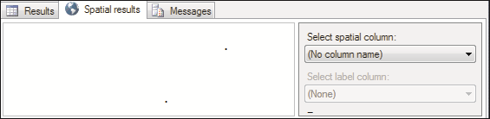
SQL
Server
2012
The following code snippet demonstrates the use of STUnion():
SQL
Server
2012
SELECT geometry::Point(251, 1, 4326).STUnion(geometry::Point(252,2,4326));
The following figure displays the output as two points:
The following code snippet displays another example:
DECLARE @City1 geography
SET @City1 = geography::STPolyFromText(
'POLYGON((175.3 -41.5, 178.3 -37.9, 172.8 -34.6, 175.3 -41.5))',
4326)

Slide 26
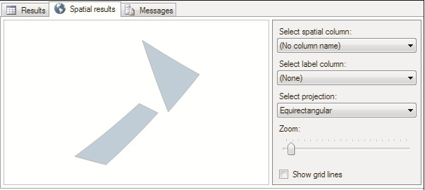
SQL
Server
2012
SQL
Server
2012
DECLARE @City2 geography
SET @City2 = geography::STPolyFromText(
'POLYGON((169.3 -46.6, 174.3 -41.6, 172.5 -40.7, 166.3 -45.8, 169.3 -
46.6))',
4326)
DECLARE @CombinedCity geography = @City1.STUnion(@City2)
SELECT @CombinedCity
Here, two variables are declared of the geography type and appropriate values are assigned to them.
Then, they are combined into a third variable of geography type by using the
STUnion() method. The following figure shows the output of the code:

Slide 27
SQL
Server
2012
SQL
Server
2012
SQL Server 2012 has introduced four new aggregates to the suite of spatial operators in SQL Server.
Union Aggregate
Envelope Aggregate Collection Aggregate Convex Hull Aggregate
These aggregates are implemented as static methods, which work for either the
geography or the geometry data types.
Although aggregates are applicable to all classes of spatial data, they can be best described with polygons.

Slide 28
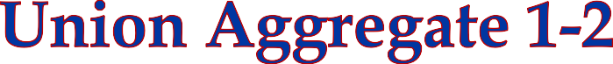
SQL
Server
2012
SQL
Server
2012
It performs a union operation on a set of geometry objects.
The syntax of UnionAggregate is as follows:
Syntax:
UnionAggregate ( geometry_operand or geography_operand)
where,
geometry_operand: is a geometry type table column comprising the set of
geometry objects on which a union operation will be performed. geography_operand: is a geography type table column comprising the set of geography objects on which a union operation will be performed.

Slide 29

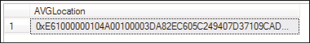
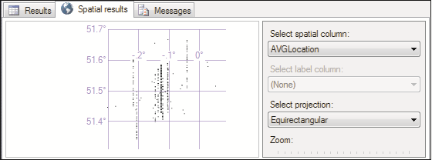
SQL
Server
2012
SQL
Server
2012
Following code snippet demonstrates a simple example of using the Union aggregate.
It uses the Person.Address table in the AdventureWorks2012 database.
SELECT Geography::UnionAggregate(SpatialLocation)
AS AVGLocation FROM Person.Address
WHERE City = 'London‘;
The following figure displays the output:
The following figure displays a visual representation of the spatial data and is viewed
by clicking the Spatial results tab in the output window:

Slide 30
SQL
Server
2012
SQL
Server
2012
It returns a bounding area for a given set of geometry or geography objects. It exhibits different behaviors for geography and geometry types.
For the geography type, the result is a circular object, which loosely bounds the selected input objects.
The following is the syntax of EnvelopeAggregate:
Syntax:
EnvelopeAggregate (geometry_operand or geography_operand)
where,
geometry_operand: is a geometry type table column comprising the set of
geometry objects.

Slide 31
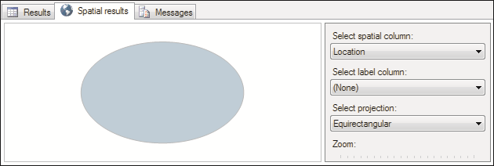
SQL
Server
2012
SQL
Server
2012
geography_operand: is a geography type table column comprising the set of geography objects.
Following code snippet returns a bounding box for a set of objects in a table variable column:
SELECT Geography::EnvelopeAggregate(SpatialLocation)
AS Location
FROM Person.Address WHERE City = 'London‘
The following figure shows the visual representation of the output:

Slide 32
SQL
Server
2012
SQL
Server
2012
It returns a GeometryCollection/GeographyCollection instance with one geometry/geography part for each spatial object(s) in the selection set.
The syntax of CollectionAggregate is as follows:
Syntax:
CollectionAggregate (geometry_operand or geography_operand)
where,
geometry_operand: is a geometry type table column comprising the set of
geometry objects.
geography_operand: is a geography type table column comprising the set of
geography objects.
Following code snippet returns a GeometryCollection instance that contains a
CurvePolygon and a Polygon:
DECLARE @CollectionDemo TABLE
(
shape geometry,

Slide 33
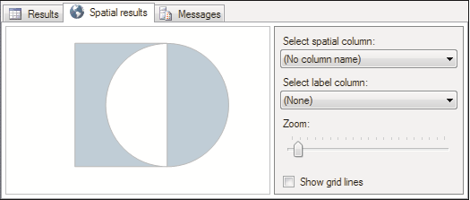
SQL
Server
2012
SQL
Server
2012
shapeType nvarchar(50)
)
INSERT INTO @CollectionDemo(shape,shapeType) VALUES('CURVEPOLYGON(CIRCULARSTRING(2 3, 4 1, 6 3, 4 5, 2 3))',
'Circle'),
('POLYGON((1 1, 4 1, 4 5, 1 5, 1 1))', 'Rectangle');
SELECT geometry::CollectionAggregate(shape) FROM @CollectionDemo;
The following figure shows the output of the code:

Slide 34
SQL
Server
2012
SQL
Server
2012
It returns a convex hull polygon, which encloses one or more spatial objects for a given set of geometry/geography objects.
The following is the syntax of ConvexHullAggregate:
Syntax:
ConvexHullAggregate (geometry_operand or geography_operand)
where,
geometry_operand: is a geometry type table column comprising the set of
geometry objects.
geography_operand: is a geography type table column comprising the set of
geography objects.

Slide 35
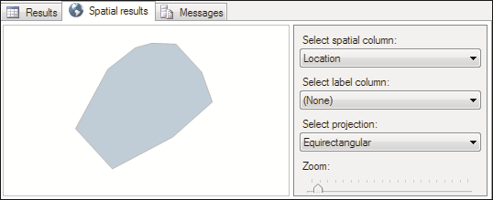
SQL
Server
2012
Following code snippet demonstrates the use of ConvexHullAggregate:
SQL
Server
2012
SELECT Geography::ConvexHullAggregate(SpatialLocation)
AS Location
FROM Person.Address WHERE City = 'London‘
The output is shown in the following figure:

Slide 36


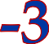
SQL
Server
2012
SQL
Server
2012
You can use a SELECT statement or a query to return records that will be used as criteria for another SELECT statement or query.
In other words, the inner query statement should return the column or columns used in the criteria of the outer query statement.
The syntax for the most basic form of a subquery using just one column with an =
sign is as follows:
Syntax:
SELECT <ColumnName> FROM <table>
WHERE <ColumnName> = ( SELECT <ColumnName> FROM <Table> WHERE
<ColumnName> = <Condition>�>)

Slide 37
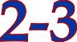
SQL
Server
2012
SQL
Server
2012
In a subquery, the innermost SELECT statement is executed first and its result is passed as criteria to the outer SELECT statement.
Consider a scenario where it is required to determine the due date and ship date of
the most recent orders.
Following code snippet shows the code to achieve this:
SELECT DueDate, ShipDate
FROM Sales.SalesOrderHeader
WHERE Sales.SalesOrderHeader.OrderDate = (SELECT MAX(OrderDate)
FROM Sales.SalesOrderHeader)
Here, a subquery has been used to achieve the desired output.
The inner query or subquery retrieves the most recent order date.
This is then passed to the outer query, which displays due date and ship date for all the orders that were made on that particular date.

Slide 38
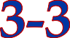
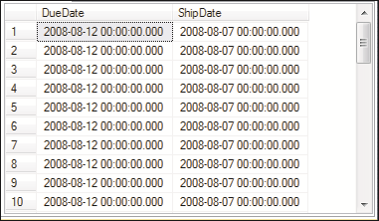
SQL
Server
2012
SQL
Server
2012
The following figure displays a part of the output of the code:
Based on the results returned by the inner query, a subquery can be classified as follows:
Scalar subqueries
returns a single value. Here, the outer query needs to be written to process a single result.
Multi-valued subqueries
returns a result similar to a single-column table. Here, the outer query needs to be written to handle multiple possible results.

Slide 39
SQL
Server
2012
SQL
Server
2012
If an = operator is used with the subquery, the subquery must return a single scalar value.
The keywords ANY, ALL, IN, and EXISTS can be used with the WHERE clause of a
SELECT statement when the query returns one column but one or more rows.
These keywords, also called predicates, are used with multi-valued queries.
Here, the inner query may return more than one row as there may be more than one employee with that job title.

Slide 40
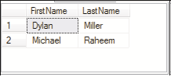
SQL
Server
2012
Following code snippet demonstrates this:
SQL
Server
2012
SELECT FirstName, LastName FROM Person.Person
WHERE Person.Person.BusinessEntityID IN (SELECT BusinessEntityID
FROM HumanResources.Employee WHERE JobTitle ='Research and Development
Manager');
Here, the inner query retrieves the BusinessEntityID from the HumanResources.Employee table for those records having job title 'Research and Development Manager'.
These results are then passed to the outer query, which matches the
BusinessEntityID with that in the Person.Person table.
Finally, from the records that are matching, the first and last names are extracted
and displayed.
The following figure displays the output:

Slide 41
SQL
Server
2012
SQL
Server
2012
You should remember the following points when using subqueries:
 | The ntext, text, and image data types cannot be used in the SELECT list of
 | subqueries.
The SELECT list of a subquery introduced with a comparison operator can have only one expression or column name.
Subqueries that are introduced by a comparison operator not followed by the
keyword ANY or ALL cannot include GROUP BY and HAVING clauses.
You cannot use DISTINCT keyword with subqueries that include GROUP BY.
You can specify ORDER BY only when TOP is also specified.

Slide 42


SQL
Server
2012
SQL
Server
2012
Besides scalar and multi-valued subqueries, you can also choose between
self-contained subqueries and correlated subqueries. These are defined as follows:
Self-contained subqueries
These queries are written as standalone queries, without any
dependencies on the outer query.
A self-contained subquery is processed once when the outer query runs and passes its results to the outer query.
Correlated subqueries
There queries reference one or more columns from the outer query
and therefore, depend on the outer query.
Correlated subqueries cannot be run separately from the outer query.

Slide 43
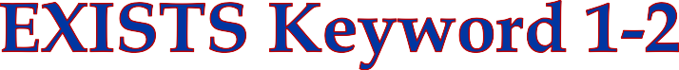
SQL
Server
2012
SQL
Server
2012
The EXISTS keyword is used with a subquery to check the existence of rows returned by the subquery.
The subquery does not actually return any data; it returns a value of TRUE or
FALSE.
The syntax of a subquery containing the word EXISTS is as follows:
Syntax:
SELECT <ColumnName> FROM <table>
WHERE [NOT] EXISTS
(
<Subquery_Statement>
)
where,
Subquery_Statement: specifies the subquery.

Slide 44
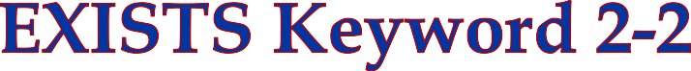
SQL
Server
2012
SQL
Server
2012
Following code snippet shows the use of the EXISTS keyword to yield the same output:
SELECT FirstName, LastName FROM Person.Person AS A
WHERE EXISTS (SELECT *
FROM HumanResources.Employee As B WHERE JobTitle ='Research and Development Manager' AND A.BusinessEntityID=B.BusinessEntityID);
Here, the inner subquery retrieves all those records that match job title as 'Research and Development Manager' and whose BusinessEntityId matches with that in the Person table.
If there are no records matching both these conditions, the inner subquery will not return any rows.
Thus, in that case, the EXISTS will return false and the outer query will also not
return any rows.
However, the code will return two rows because the given conditions are satisfied.
Similarly, one can use the NOT EXISTS keyword.
The WHERE clause in which it is used is satisfied if there are no rows returned by the subquery.

Slide 45


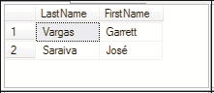
SQL
Server
2012
SQL
Server
2012
A subquery that is defined inside another subquery is called a nested subquery.
Consider that you wanted to retrieve and display the names of persons from Canada.
There is no direct way to retrieve this information since the
Sales.SalesTerritory table is not related to Person.Person table.
Hence, a nested subquery is used here as shown in the following code snippet:
SELECT LastName, FirstName
FROM Person.Person
WHERE BusinessEntityID IN (SELECT BusinessEntityID FROM Sales.SalesPerson WHERE TerritoryID IN (SELECT TerritoryID
FROM Sales.SalesTerritory WHERE Name='Canada')
)
The following figure displays the output:

Slide 46
SQL
Server
2012
SQL
Server
2012
When a subquery takes parameters from its parent query, it is known as Correlated subquery.
The following code snippet displays the use of a correlated subquery:
SELECT e.BusinessEntityID
FROM Person.BusinessEntityContact e WHERE e.ContactTypeID IN
(
SELECT c.ContactTypeID
FROM Person.ContactType c
WHERE YEAR(e.ModifiedDate) >=2012
)

Slide 47
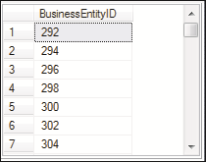
SQL
Server
2012
SQL
Server
2012
In the code, the inner query retrieves contact type ids for all those persons whose contact information was modified on or before 2012.
These results are then passed to the outer query, which matches these contact type ids with those in the Person.BusinessEntityContact table and displays the business entity IDs of those records.
Following figure shows part of the output:

Slide 48
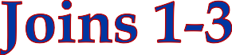
SQL
Server
2012
SQL
Server
2012
Joins are used to retrieve data from two or more tables based on a logical
relationship between tables.
It defines the manner in which two tables are related in a query by:
Specifying the column from each table to be used for the join. A typical join specifies a foreign key from one table and its associated key in the other table.
Joins can be specified in either the FROM or WHERE clauses.
The syntax of the JOIN statement is as follows:
Syntax:
SELECT <ColumnName1>, <ColumnName2>...<ColumnNameN>
FROM Table_A AS Table_Alias_A
JOIN
Table_B AS Table_Alias_B ON
Table_Alias_A.<CommonColumn> = Table_Alias_B.<CommonColumn>
where,
<ColumnName1>, <ColumnName2>: Is a list of columns that need to be
Advanced Queries and Joins/ Session 9
48

Slide 49
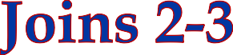
SQL
Server
2012
SQL
Server
2012
Table_A: Is the name of the table on the left of the JOIN keyword.
Table_B: Is the name of the table on the right of the JOIN keyword.
AS Table_Alias: Is a way of giving an alias name to the table. An alias defined for the table in a query can be used to denote a table so that the full name of the table
need not be used.
<CommonColumn>: Is a column that is common to both the tables. In this case, the
join succeeds only if the columns have matching values.
Consider that you want to list employee first names, last names, and their job titles from the HumanResources.Employee and Person.Person.
To extract this information from the two tables, you need to join them based on
BusinessEntityID as shown in the following code snippet:
SELECT A.FirstName, A.LastName, B.JobTitle
FROM Person.Person A
JOIN
HumanResources.Employee B ON
A.BusinessEntityID = B.BusinessEntityID;

Slide 50

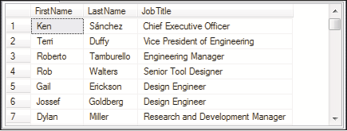
SQL
Server
2012
SQL
Server
2012
Here, the tables HumanResources.Employee and Person.Person are given aliases A and B. They are joined together on the basis of their business entity ids.
The SELECT statement then retrieves the desired columns through the aliases.
Following figure shows the output:

Slide 51

SQL
Server
2012
SQL
Server
2012
An inner join is formed when records from two tables are combined only if the rows from both the tables are matched based on a common column.
The syntax of an inner join is as follows:
Syntax:
SELECT <ColumnName1>, <ColumnName2>...<ColumnNameN> FROM
Table_A AS Table_Alias_A
INNER JOIN
Table_B AS Table_Alias_B ON
Table_Alias_A.<CommonColumn> = Table_Alias_B.<CommonColumn>
Following code snippet demonstrates the use of inner join:
SELECT A.FirstName, A.LastName, B.JobTitle
FROM Person.Person A
INNER JOIN HumanResources.Employee B
ON
A.BusinessEntityID = B.BusinessEntityID;
Here, an inner join is constructed between Person.Person and
HumanResources.Employee based on common business entity ids.

Slide 52


SQL
Server
2012
SQL
Server
2012
Outer joins are join statements that return all rows from at least one of the tables specified in the FROM clause, as long as those rows meet any WHERE or HAVING conditions of the SELECT statement.
The two types of commonly used outer joins are as follows:
Left Outer Join
Right Outer Join

Slide 53
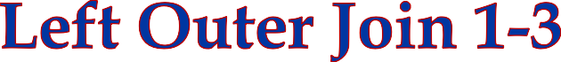
SQL
Server
2012
SQL
Server
2012
Left outer join returns all the records from the left table and only matching records from the right table.
The syntax of an outer join is as follows:
Syntax:
SELECT <ColumnList> FROM
Table_A AS Table_Alias_A
LEFT OUTER JOIN
Table_B AS Table_Alias_B ON
Table_Alias_A.<CommonColumn> = Table_Alias_B.<CommonColumn>
Consider that you want to retrieve all the customer ids from the Sales.Customers table and order information such as ship dates and due dates, even if the customers have not placed any orders.
Since the record count would be very huge, it is to be restricted to only those orders that are placed before 2012.

Slide 54
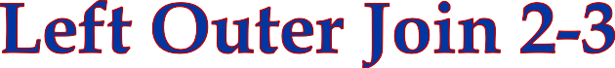
SQL
Server
2012
The following code snippet achieves this by performing a left outer join:
SQL
Server
2012
SELECT A.CustomerID, B.DueDate, B.ShipDate FROM Sales.Customer A LEFT OUTER JOIN Sales.SalesOrderHeader B
ON
A.CustomerID = B.CustomerID AND YEAR(B.DueDate)<2012;
In the query, the left outer join is constructed between the tables
Sales.Customer and Sales.SalesOrderHeader.
The tables are joined on the basis of customer ids.
In this case, all records from the left table, Sales.Customer and only matching
records from the right table, Sales.SalesOrderHeader, are returned.

Slide 55
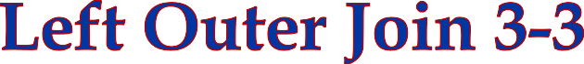
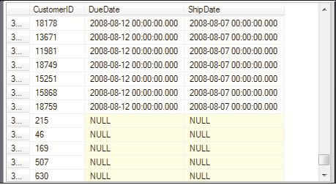
SQL
Server
2012
SQL
Server
2012
Following figure shows the output:
As shown in the output, some records show the due dates and ship dates as NULL.
This is because for some customers, no order is placed, hence, their records will show the dates as NULL.

Slide 56
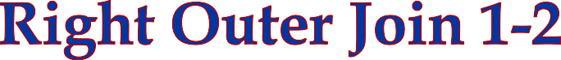
SQL
Server
2012
SQL
Server
2012
The right outer join retrieves all the records from the second table in the join regardless of whether there is matching data in the first table or not.
The syntax of a right outer join is as follows:
Syntax:
SELECT <ColumnList> FROM Left_Table_Name AS
Table_A AS Table_Alias_A RIGHT OUTER JOIN
Table_B AS Table_Alias_B ON
Table_Alias_A.<CommonColumn> = Table_Alias_B.<CommonColumn>

Slide 57
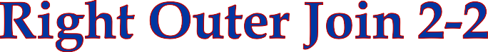
SQL
Server
2012
SQL
Server
2012
Consider that you want to retrieve all the product names from Product table and all the corresponding sales order ids from the SalesOrderDetail table even if there is no matching record for the products in the SalesOrderDetail table.
The following code snippet achieve this by using a right outer join:
SELECT P.Name, S.SalesOrderID FROM Sales.SalesOrderDetail S RIGHT OUTER JOIN
Production.Product P
ON P.ProductID = S.ProductID;
In the code, all the records from Product table are shown regardless of whether they have been sold or not.

Slide 58
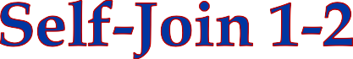
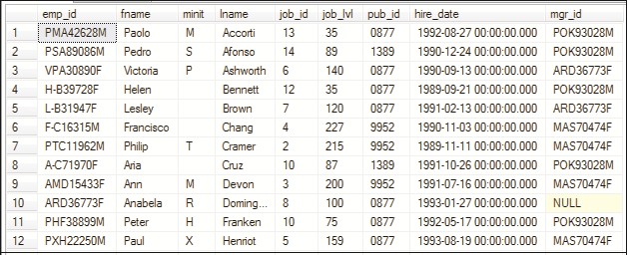
SQL
Server
2012
SQL
Server
2012
A self-join is used to find records in a table that are related to other records in the same table. A table is joined to itself in a self-join.
Consider that an Employee table in a database named Sterling has a column
named mgr_id to denote information for managers whom employees are reporting to.
Assume that the table has appropriate records inserted in it.
A manager is also an employee. This means that the mgr_id in the table is the
emp_id of an employee.
For example, Anabela with emp_id as ARD36773F is an employee but Anabela is
also a manager for Victoria, Palle, Karla, and other employees as shown in the following figure:

Slide 59
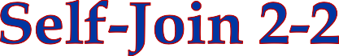
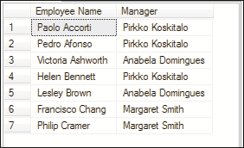
SQL
Server
2012
SQL
Server
2012
To get a list of the manager names along with other details, you can use a self-join to join the employee table with itself and then, extract the desired records.
Following code snippet demonstrates how to use a self-join:
SELECT TOP 7 A.fname + ' ' + A.lname AS 'Employee Name', B.fname + ' '+B.lname AS 'Manager'
FROM
Employee AS A INNER JOIN
Employee AS B
ON A.mgr_id = B.emp_id
In the code, the Employee table is joined to itself based on the mgr_id and
emp_id columns.
The following figure displays the output of the code:

Slide 60
SQL
Server
2012
SQL
Server
2012
The MERGE statement allows you to maintain a target table based on certain join conditions on a source table using a single statement.
You can now perform the following actions in one MERGE statement:
Insert a new row from the source if the row is missing in the target
Update a target row if a record already exists in the source table Delete a target row if the row is missing in the source table
For example, assume you have a Products table that maintains records of all products.
A NewProducts table maintains records of new products.
You want to update the Products table with records from the NewProducts
table.

Slide 61
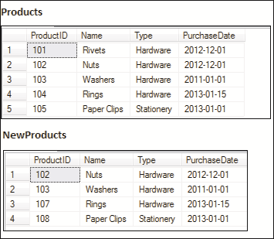
SQL
Server
2012
Here, NewProducts table is the source table and Products is the target table.
The Products table contains records of existing products with updated data and
new products.
Following figure shows the two tables:
SQL
Server
2012

Slide 62
SQL
Server
2012
SQL
Server
2012
Consider that you want to:
Compare last and first names of customers from both source and target tables
Update customer information in target table if the last and first names match
Insert new records in target table if the last and first names in source table do not exist in target table
Delete existing records in target table if the last and first names do not match with those of source table
MERGE also allows you to optionally display those records that were inserted, updated, or deleted by using an OUTPUT clause.
The syntax of the MERGE statement is as follows:
MERGE target_table
USING source_table
ON match_condition
WHEN MATCHED THEN UPDATE SET Col1 = val1 [, Col2 = val2...]
WHEN [TARGET] NOT MATCHED THEN INSERT (Col1 [,Col2...] VALUES (Val1 [, Val2...])
WHEN NOT MATCHED BY SOURCE THEN DELETE
[OUTPUT $action, Inserted.Col1, Deleted.Col1,...] ;
where,
target_table: is the table WHERE changes are being made.

Slide 63
SQL
Server
2012
SQL
Server
2012
source_table: is the table from which rows will be inserted, updated, or deleted into the target table.
match_conditions: are the JOIN conditions and any other comparison
operators.
MATCHED: true if a row in the target_table and source_table matches the
match_condition.
NOT MATCHED: true if a row from the source_table does not exist in the
target_table.
SOURCE NOT MATCHED: true if a row exists in the target_table but not in the source_table.
OUTPUT: An optional clause that allows to view those records that have been inserted/deleted/updated in target_table.
MERGE statements are terminated with a semi-colon (;).

Slide 64
SQL
Server
2012
SQL
Server
2012
Following code snippet shows how to use MERGE statement. It makes use of the
Sterling database:
MERGE INTO Products AS P1
USING
NewProducts AS P2
ON P1.ProductId = P2.ProductId
WHEN MATCHED THEN
UPDATE SET
P1.Name = P2.Name, P1.Type = P2.Type,
P1.PurchaseDate = P2.PurchaseDate
WHEN NOT MATCHED THEN
INSERT (ProductId, Name, Type, PurchaseDate)
VALUES (P2.ProductId, P2.Name, P2.Type, P2.PurchaseDate) WHEN NOT MATCHED BY SOURCE THEN
DELETE
OUTPUT $action, Inserted.ProductId, Inserted.Name, Inserted.Type,
Inserted.PurchaseDate, Deleted.ProductId,Deleted.Name, Deleted.Type, Deleted.PurchaseDate;

Slide 65
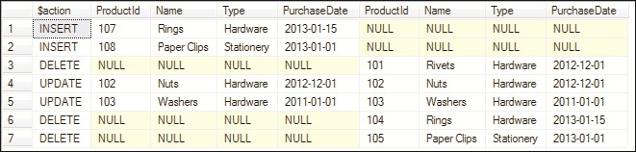
SQL
Server
2012
SQL
Server
2012
Following figure shows the output:
The NewProducts table is the source table and Products table is the target table.
The match condition is the column, ProductId of both tables.
If the match condition evaluates to false (NOT MATCHED), then new records are inserted in the target table.
If match condition evaluates to true (MATCHED), then records are updated into the
target table from the source table.
If records present in the target table do not match with those of source table (NOT
MATCHED BY SOURCE), then these are deleted from the target table.
The last statement displays a report consisting of rows that were inserted/updated/deleted as shown in the output.

Slide 66
SQL
Server
2012
SQL
Server
2012
CTE is similar to a temporary resultset defined within the execution scope of a single
SELECT, INSERT, UPDATE, DELETE, or CREATE VIEW statement.
A CTE is defined at the start of a query and can be referenced several times in the outer query.
Key advantages of CTEs are improved readability and ease in maintenance of complex queries.
The syntax to create a CTE is as follows:
Syntax:
WITH <CTE_name>
AS ( <CTE_definition> )

Slide 67
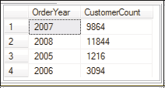
SQL
Server
2012
SQL
Server
2012
The following code snippet retrieves and displays the customer count year-wise for orders present in the Sales.SalesOrderHeader table:
WITH CTE_OrderYear
AS (
SELECT YEAR(OrderDate) AS OrderYear, CustomerID FROM Sales.SalesOrderHeader
)
SELECT OrderYear, COUNT(DISTINCT CustomerID) AS CustomerCount FROM CTE_OrderYear
GROUP BY OrderYear;
Here, CTE_OrderYear is specified as the CTE name.
The WITH...AS keywords begins the CTE definition.
Then, the CTE is used in the SELECT statement to retrieve and display the desired results. Following figure shows the output:

Slide 68
SQL
Server
2012
SQL
Server
2012
The following guidelines need to be remembered while defining CTEs:
 | CTEs are limited in scope to the execution of the outer query. Hence, when the
 | outer query ends, the lifetime of the CTE will end.
You need to define a name for a CTE and also, define unique names for each of the columns referenced in the SELECT clause of the CTE.
It is possible to use inline or external aliases for columns in CTEs.
A single CTE can be referenced multiple times in the same query with one definition.
Multiple CTEs can also be defined in the same WITH clause.

Slide 69
SQL
Server
2012
Following code snippet defines two CTEs using a single WITH clause:
WITH CTE_Students
AS
(
Select StudentCode, S.Name,C.CityName, St.Status FROM Student S
INNER JOIN City C
ON S.CityCode = C.CityCode
INNER JOIN Status St
ON S.StatusId = St.StatusId)
,
StatusRecord –- This is the second CTE being defined
AS
(
SELECT Status, COUNT(Name) AS CountofStudents FROM CTE_Students
GROUP BY Status
)
SELECT * FROM StatusRecord
SQL
Server
2012

Slide 70
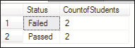
SQL
Server
2012
SQL
Server
2012
The code defines two CTEs using a single WITH clause.
This snippet assumes that three tables named Student, City, and Status are
created.
Assuming some records are inserted in all three tables, the output may be as shown in the following figure:

Slide 71
SQL
Server
2012
SQL
Server
2012
The results from two different query statements can be combined into a single resultset using the UNION operator.
The column names can be different in each statement but the data types must be compatible.
The syntax of the UNION operator is as follows:
Syntax:
Query_Statement1
UNION [ALL]
Query_Statement2
where,
Query_Statement1 and Query_Statement2 are SELECT statements.

Slide 72
SQL
Server
2012
Following code snippet demonstrates the use of UNION operator:
SQL
Server
2012
SELECT Product.ProductId FROM Production.Product
UNION
SELECT ProductId FROM Sales.SalesOrderDetail
This will list all the product ids of both tables that match with each other.
If you include the ALL clause, all rows are included in the resultset including
duplicate records.
SELECT Product.ProductId FROM Production.Product
UNION ALL
SELECT ProductId FROM Sales.SalesOrderDetail
By default, the UNION operator removes duplicate records from the resultset.
However, if you use the ALL clause with UNION operator, then all the rows are returned.
Apart from UNION, the other operators that are used to combine data from
multiple tables are INTERSECT and EXCEPT.

Slide 73
SQL
Server
2012
SQL
Server
2012
The INTERSECT operator is used with two query statements to return a distinct set of rows that are common to both the query statements.
The syntax of the INTERSECT operator is as follows:
Syntax:
Query_statement1
INTERSECT
Query_statement2
where,
Query_Statement1 and Query_Statement2 are SELECT statements.
Following code snippet demonstrates the use of INTERSECT operator:
SELECT Product.ProductId FROM Production.Product
INTERSECT
SELECT ProductId FROM Sales.SalesOrderDetail

Slide 74
SQL
Server
2012
SQL
Server
2012
The basic rules for using INTERSECT are as follows:
 | The number of columns and the order in which they are given must be the same
 | in both the queries.
The data types of the columns being used must be compatible.
The result of the intersection of the Production.Product and Sales.SalesOrderDetail tables would be only those product ids that have matching records in Production.Product table.

Slide 75

SQL
Server
2012
SQL
Server
2012
The EXCEPT operator returns all the distinct rows from the query given on the left of the EXCEPT operator and removes all the rows from the resultset that match the rows on the right of the EXCEPT operator.
The syntax of the EXCEPT operator is as follows:
Syntax:
Query_statement1
EXCEPT
Query_statement2
where,
Query_Statement1 and Query_Statement2 are SELECT statements.
The two rules that apply to INTERSECT operator are also applicable for EXCEPT
operator.

Slide 76
SQL
Server
2012
Following code snippet demonstrates the use of EXCEPT:
SQL
Server
2012
SELECT Product.ProductId FROM Production.Product
EXCEPT
SELECT ProductId FROM Sales.SalesOrderDetail
If the order of the two tables in this example is interchanged, only those rows are
returned from Production.
Product table which do not match with the rows present in
Sales.SalesOrderDetail.
Thus, EXCEPT operator selects all the records from the first table except those which match with the second table.
Hence, when you are using EXCEPT operator, the order of the two tables in the queries is important.
Whereas, with the INTERSECT operator, it does not matter which table is specified first.

Slide 77

SQL
Server
2012
SQL
Server
2012
The brief syntax for PIVOT operator is as follows:
Syntax:
SELECT <non-pivoted column>,
[first pivoted column] AS <column name>, [second pivoted column] AS <column name>,
...
[last pivoted column] AS <column name>
FROM
(<SELECT query that produces the data>) AS <alias for the source query>
PIVOT
(
<aggregation function>(<column being aggregated>)
FOR
[<column that contains the values that will become column headers>] IN ( [first pivoted column], [second pivoted column],
... [last pivoted column])
) AS <alias for the pivot table>
<optional ORDER BY clause>;

Slide 78
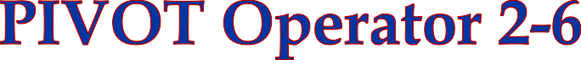
SQL
Server
2012
SQL
Server
2012
where,
table_source: is a table or table expression.
aggregate_function: is a user-defined or in-built aggregate function that accepts one or more inputs.
value_column: is the value column of the PIVOT operator.
pivot_column: is the pivot column of the PIVOT operator. This column must be of a type that can implicitly or explicitly be converted to nvarchar().
IN (column_list): are values in the pivot_column that will become the column names of the output table. The list must not include any column names that already exist in the input table_source being pivoted.
table_alias: is the alias name of the output table.
The output of this will be a table containing all columns of the table_source
except the pivot_column and value_column.
These columns of the table_source, excluding the pivot_column and
value_column, are called the grouping columns of the pivot operator.

Slide 79

SQL
Server
2012
SQL
Server
2012
In simpler terms, to use the PIVOT operator, you need to supply three elements to the operator:
Grouping
In the FROM clause, the input columns must be provided.
The PIVOT operator uses those columns to determine which column(s) to use for grouping the data for aggregation.
Spreading
Here, a comma-separated list of values that occur in the source data is provided that will be used as the column headings for the pivoted data.
Aggregation
An aggregation function, such as SUM, to be performed on the
grouped rows.

Slide 80

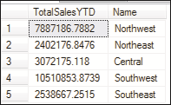
SQL
Server
2012
SQL
Server
2012
Following code snippet is shown without the PIVOT operator and demonstrates a simple GROUP BY aggregation.
As the number of records would be huge, the resultset is limited to 5 by specifying
TOP 5.
SELECT TOP 5 SUM(SalesYTD) AS TotalSalesYTD, Name
FROM Sales.SalesTerritory GROUP BY Name
Following figure shows the output:

Slide 81

SQL
Server
2012
SQL
Server
2012
The top 5 year to date sales along with territory names grouped by territory names are displayed.
The same query is rewritten in the following code snippet using a PIVOT so that the
data is transformed from a row-based orientation to a column-based orientation:
-- Pivot table with one row and six columns SELECT TOP 5 'TotalSalesYTD' AS GrandTotal,
[Northwest], [Northeast], [Central], [Southwest],[Southeast] FROM
(SELECT TOP 5 Name, SalesYTD
FROM Sales.SalesTerritory
) AS SourceTable PIVOT
(
SUM(SalesYTD)
FOR Name IN ([Northwest], [Northeast], [Central], [Southwest], [Southeast])
) AS PivotTable;

Slide 82

SQL
Server
2012
SQL
Server
2012
Following figure shows the output:
As shown in the figure, the data is transformed and the territory names are now seen as columns instead of rows. This improves readability.
A major challenge in writing queries using PIVOT is the need to provide a fixed list of spreading elements to the PIVOT operator, such as the specific territory names given in the code.
It would not be feasible or practical to implement this for large number of spreading elements.
To overcome this, developers can use dynamic SQL.
Dynamic SQL provides a means to build a character string that is passed to SQL Server, interpreted as a command, and then, executed.

Slide 83
SQL
Server
2012
SQL
Server
2012
UNPIVOT performs almost the reverse operation of PIVOT, by rotating columns into rows.
Unpivoting does not restore the original data.
UNPIVOT has no ability to allocate values to return to the original detail values.
Instead of turning rows into columns, unpivoting results in columns being transformed into rows.
SQL Server provides the UNPIVOT table operator to return a row-oriented tabular
display from a pivoted data.
When unpivoting data, one or more columns are defined as the source to be converted into rows.
The data in those columns is spread, or split, into one or more new rows, depending on how many columns are being unpivoted.
To use the UNPIVOT operator, you need to provide three elements as follows:
Source columns to be unpivoted
A name for the new column that will display the unpivoted values
A name for the column that will display the names of the unpivoted values

Slide 84
SQL
Server
2012
SQL
Server
2012
Following code snippet shows the code to convert the temporary pivot table into a permanent one so that the same table can be used for demonstrating UNPIVOT operations:
-- Pivot table with one row and six columns SELECT TOP 5 'TotalSalesYTD' AS GrandTotal,
[Northwest], [Northeast], [Central], [Southwest],[Southeast]
FROM
(SELECT TOP 5 Name, SalesYTD
FROM Sales.SalesTerritory
) AS SourceTable
PIVOT
(
SUM(SalesYTD)
FOR Name IN ([Northwest], [Northeast], Central], [Southwest], [Southeast])
) AS PivotTable;

Slide 85
SQL
Server
2012
Following code snippet demonstrates the use of UNPIVOT operator:
SQL
Server
2012
SELECT Name, SalesYTD FROM
(SELECT GrandTotal, Northwest, Northeast, Central, Southwest, Southeast FROM TotalTable) P
UNPIVOT
(SalesYTD FOR Name IN
(Northwest, Northeast, Central, Southwest, Southeast)
)AS unpvt;
The following figure displays the output:

Slide 86



SQL
Server
2012
SQL
Server
2012
The GROUPING SETS operator allows you to group together multiple groupings of
columns followed by an optional grand total row, denoted by parentheses, ().
The syntax of the GROUPING SETS operator is as follows:
Syntax:
GROUP BY
GROUPING SETS ( <grouping set list> )
where,
grouping set list: consists of one or more columns, separated by commas.
A pair of parentheses, (), without any column name denotes grand total.

Slide 87
SQL
Server
2012
SQL
Server
2012
Following code snippet demonstrates the GROUPING SETS operator.
It assumes that a table Students is created with fields named Id, Name, and
Marks respectively.
SELECT Id, Name, AVG(Marks) Marks FROM Students
GROUP BY GROUPING SETS (
(Id, Name, Marks), (Id),
()
)

Slide 88

SQL
Server
2012
SQL
Server
2012
Following figure shows the output of the code:
Here, the code uses GROUPING SETS to display average marks for every student.
NULL values in Name indicate average marks for every student.
NULL value in both Id and Name columns indicate grand total.

Slide 89

SQL
Server
2012
SQL
Server
2012
The GROUP BY clause and aggregate functions enabled to group and/or aggregate data together in order to present summarized information.
Spatial aggregate functions are newly introduced in SQL Server 2012.
A subquery allows the resultset of one SELECT statement to be used as criteria for another SELECT statement.
Joins help you to combine column data from two or more tables based on a logical relationship between the tables.
Set operators such as UNION and INTERSECT help you to combine row data from two or more tables.
The PIVOT and UNPIVOT operators help to change the orientation of data from column-oriented to row-oriented and vice versa.
The GROUPING SET subclause of the GROUP BY clause helps to specify multiple groupings in a single query.

